Slide 1

Capstone Project On
Bike Sharing Demand Prediction
TEAM MEMBERS
Bikesh Kumar Maharana
Pratyush Kumar Rath
Gourav Singh

Slide 2
CONTENT
❏ BUSINESS UNDERSTANDING
❏ DATA SUMMARY
❏ FEATURE ANALYSIS
❏ EXPLORATORY DATA ANALYSIS
❏ DATA PREPROCESSING
❏ IMPLEMENTING ALGORITHMS
❏ CONCLUSIONS

Slide 3
Business Understanding
➢ Bike rentals have became a popular service in recent years and it seems people are using it more often. With relatively cheaper rates and ease of pick up and drop at own convenience is what making this business thrive.
➢ Mostly used by people having no personal vehicles and also to avoid congested public transport which that’s why they prefer rental bikes.
➢ Therefore, the business to strive and profit more, it has to be always ready and supply number of bikes at different locations, to fulfil the demand.
➢ Our project goal is a pre planned set of bike count values that can be a handy solution to meet all demands.

Slide 4
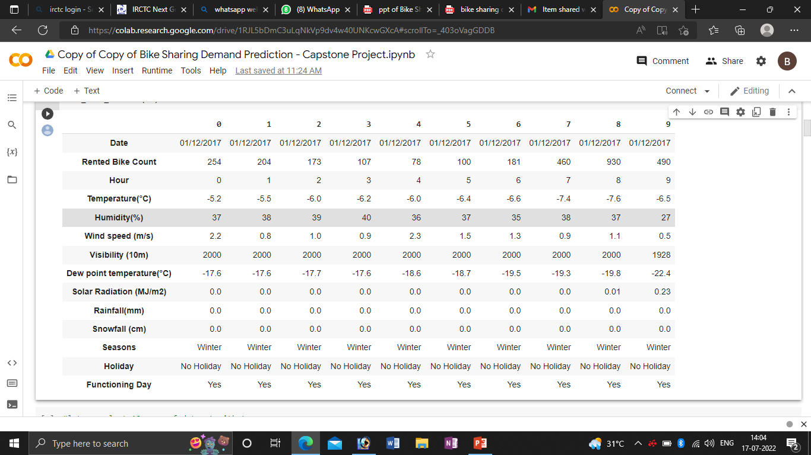
Data summary
➢ This Dataset contains 8760 lines and 14 columns.
➢ Three categorical features ‘Seasons’, ‘Holiday’, & ‘Functioning Day’.
➢ One Datetime features ‘Date’.
➢ We have some numerical type variables such as temperature, humidity, wind, visibility, dew point temp, solar radiation, rainfall, snowfall which tells the environment conditions at that particular hour of the day.

Slide 5
Feature summary
➢ Date : Year-Month-Day
➢ Rented Bike Count - Count of bikes rented at each hour
➢ Hour - Hour of the day
➢ Temperature - Temperature in Celsius
➢ Humidity - %
➢ Wind Speed - m/s
➢ Visibility - 10m
➢ Dew point temperature -Celsius
➢ Solar radiation -MJ/m2
➢ Rainfall -mm
➢ Snowfall -cm
➢ Seasons -Winter, Spring, Summer, Autumn
➢ Holiday -Holiday/No Holiday
➢ Functioning Day

Slide 6
Insights from our dataset
➢ There are No Missing Values present .
➢ There are No Duplicate values present.
➢ There are No null values.
➢ And finally we have 'rented bike count' the dependable variable which we need to predict for new observations .
➢ The dataset shows hourly rental data for one year (1 December 2017 to 31 November(2018)(365 days).We consider this as a single year data.
➢ So we convert the "date" column into 3 different column i.e "year","month","day".
➢ We remove the datas having Zero bike count. It mostly found that the non functiong days having the most zero bike count rate. Hence we also rmoved the feature for betterment of our model.

Slide 7
EXPLORATORY DATA ANALYSIS

Slide 8
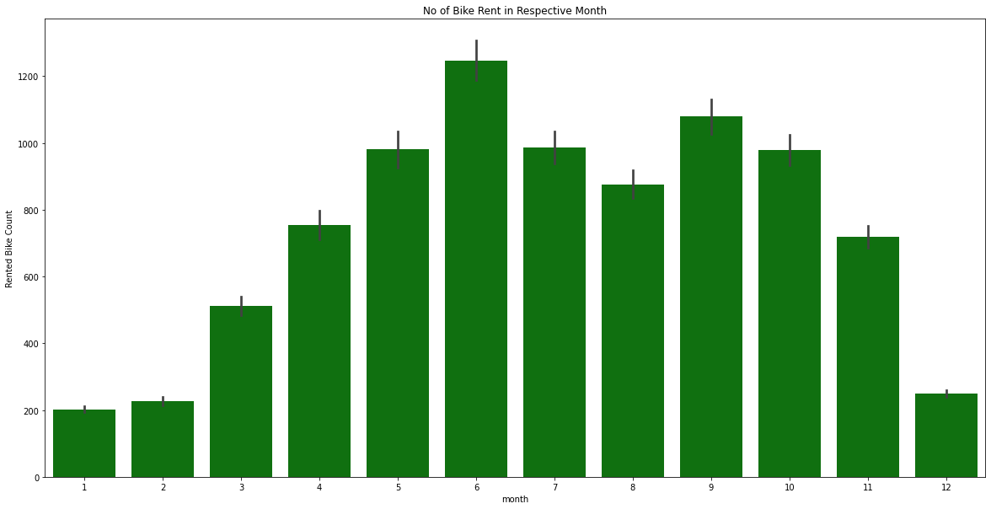
Analysis of Month vs Rented bike

Slide 9
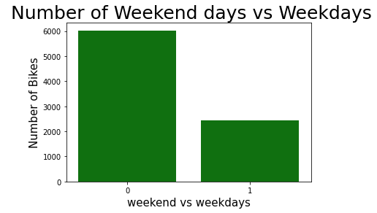
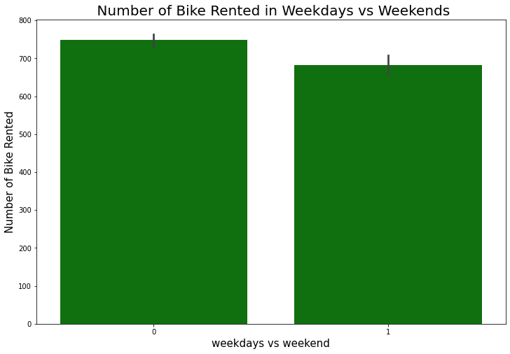
Analysis of rented bike
(Weekend vs weekdays)

Slide 10
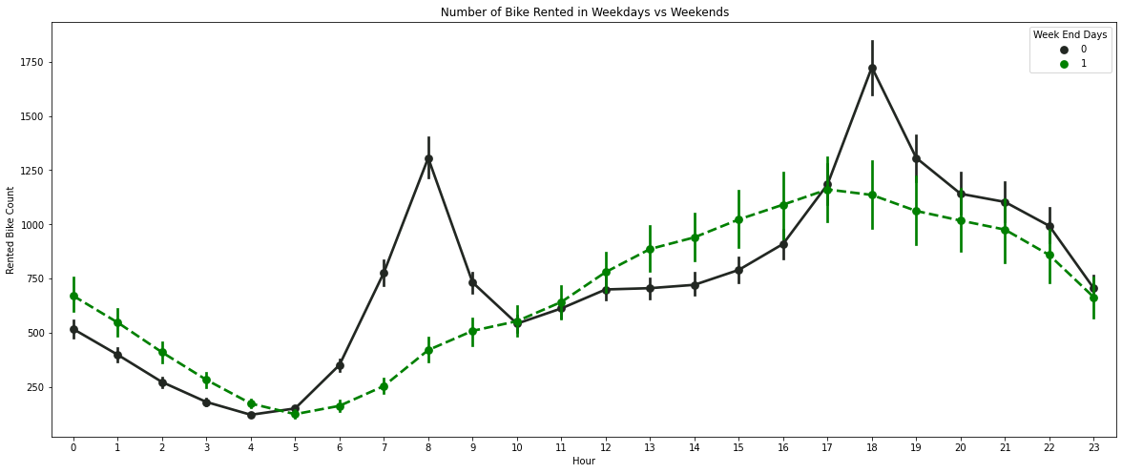
Analysis of rented bike
(HOUR)

Slide 11
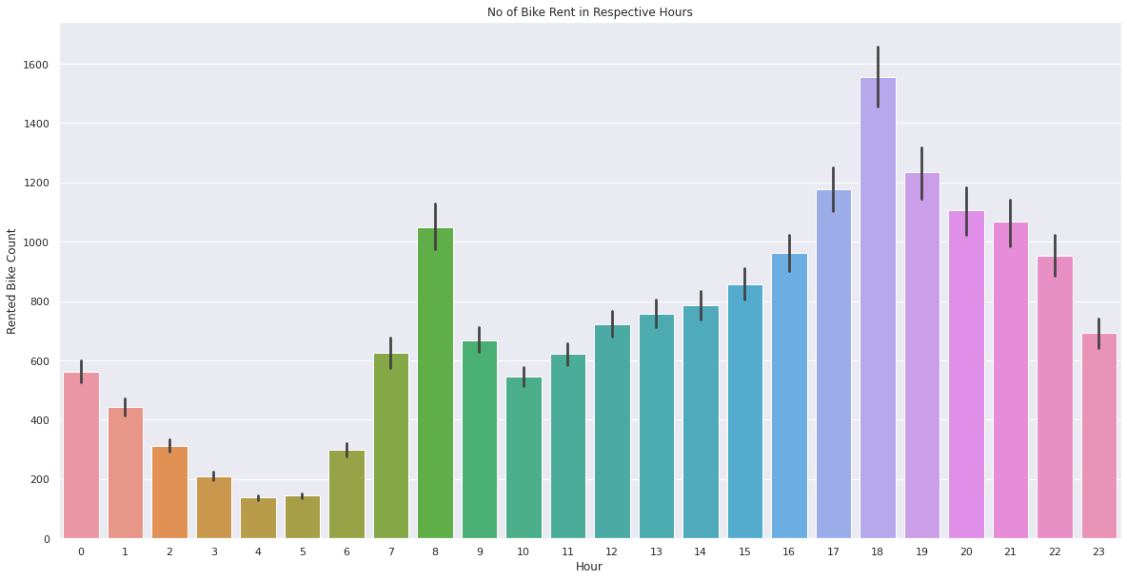
Analysis of rented bike
(HOUR)

Slide 12
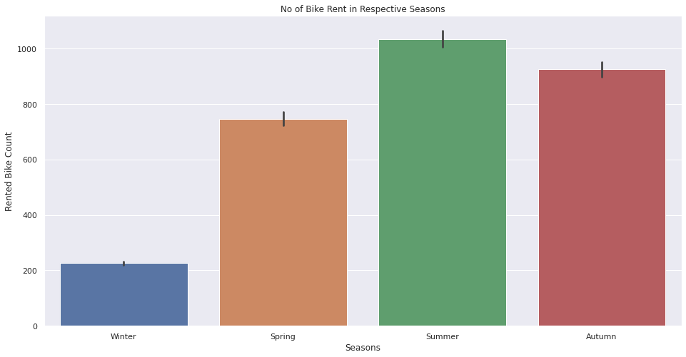
Analysis of rented bike
(SEASON)

Slide 13
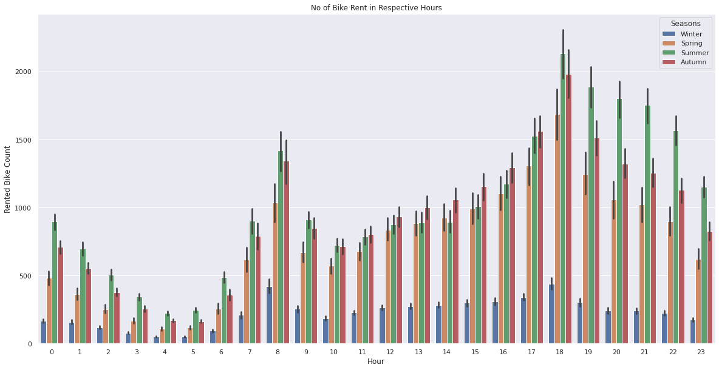
Analysis of rented bike
(Hour and season)

Slide 14
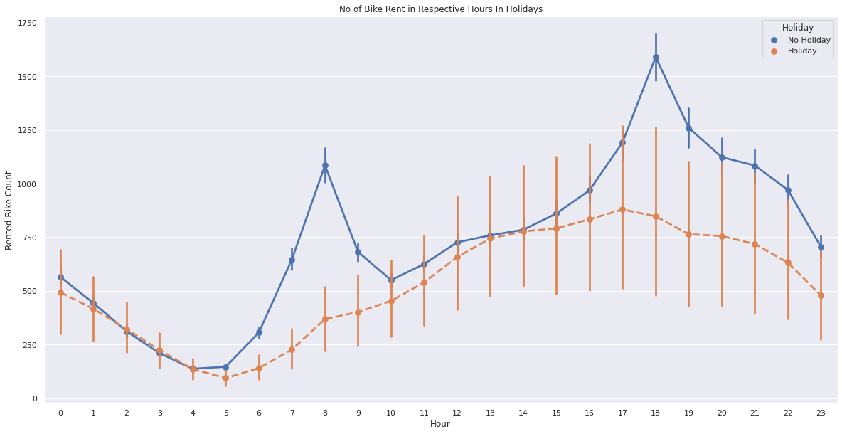
Analysis of rented bike
(Hour and holiday)

Slide 15
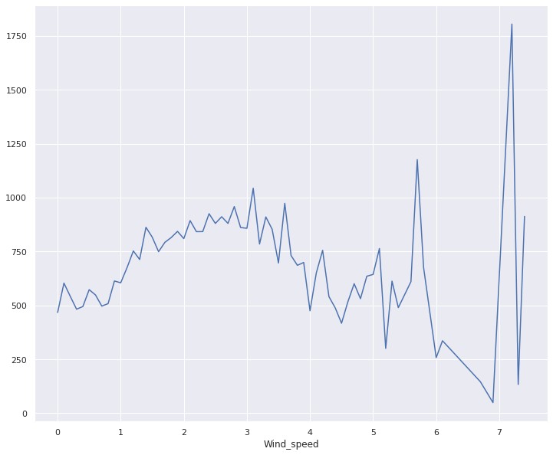
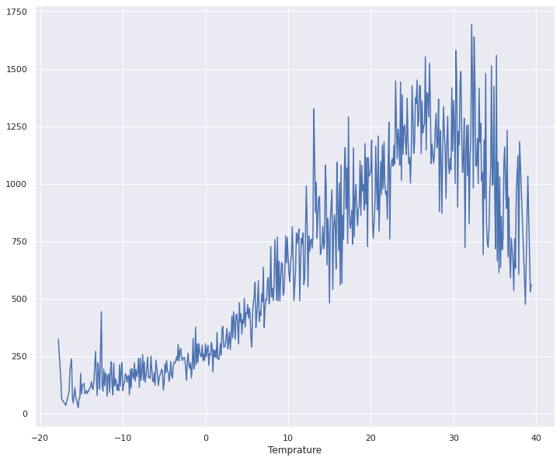
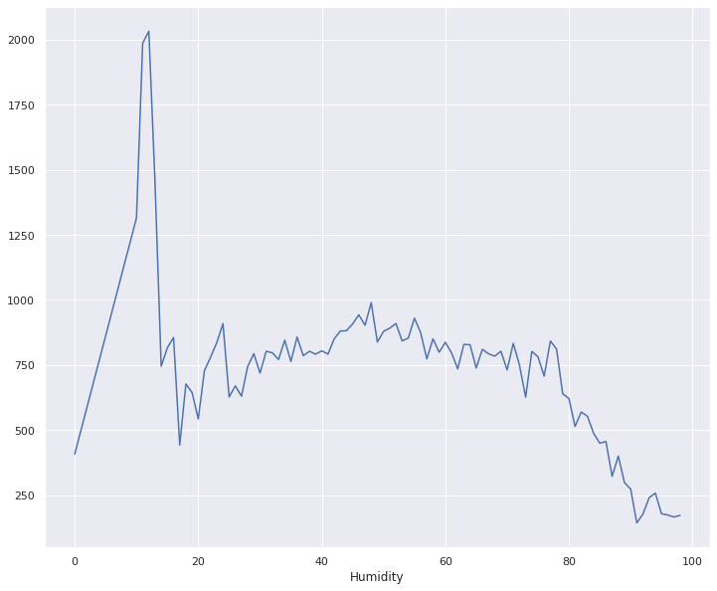
Numerical Features vs Rented bike count
WIND SPEED
TEMPERATURE
HUMIDITY

Slide 16
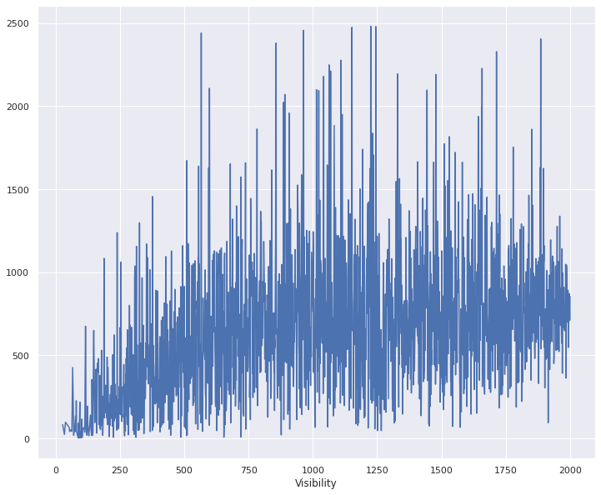
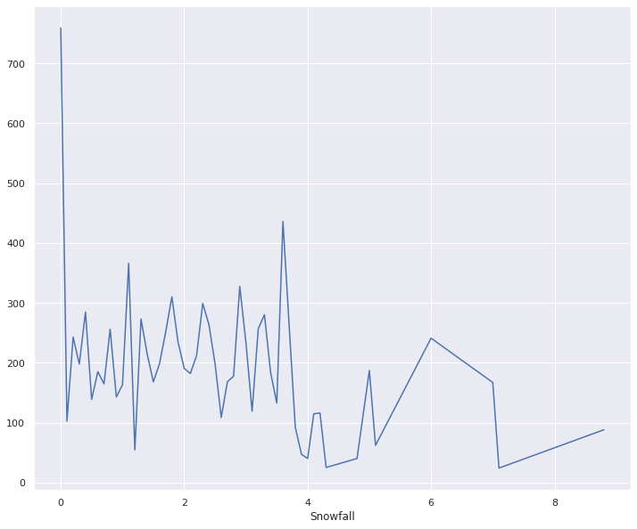
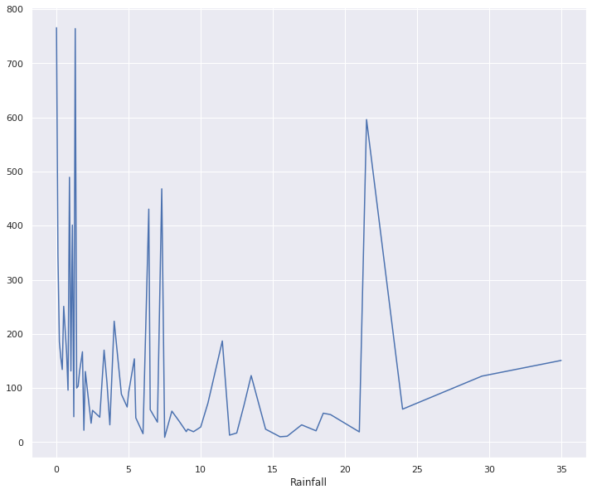
Numerical vs Rented bike count
VISIBILITY
SNOW FALL
RAIN FALL

Slide 17
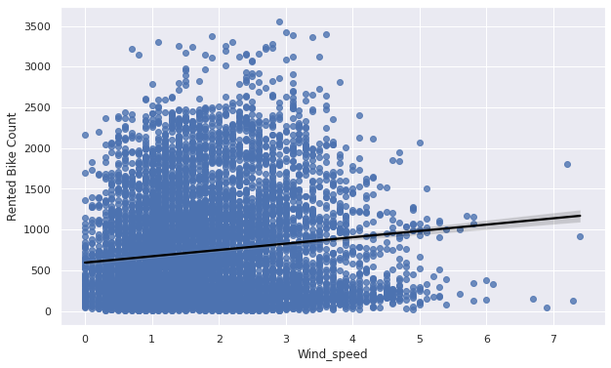
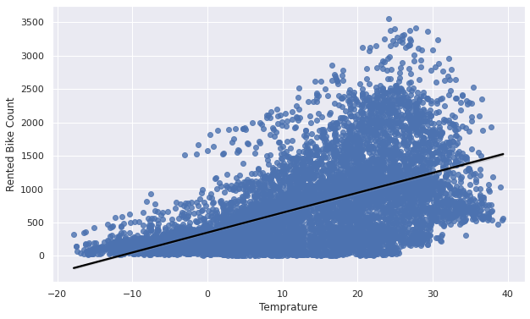
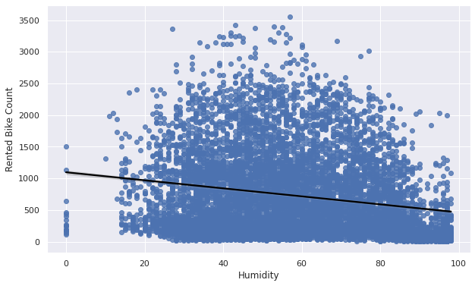
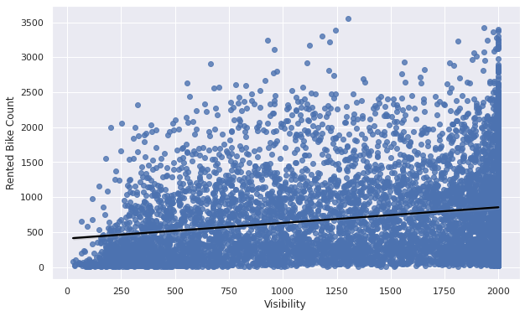
Regression Plot for numerical variable

Slide 18
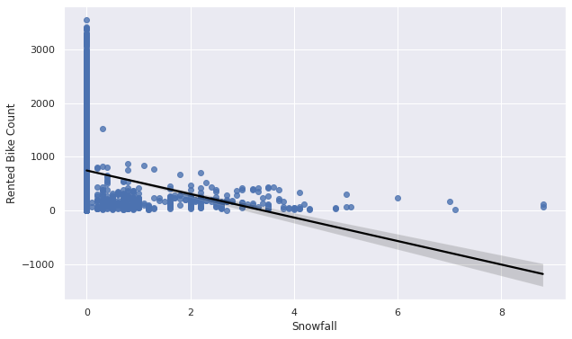
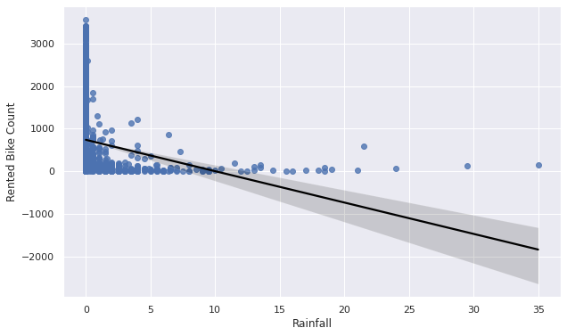
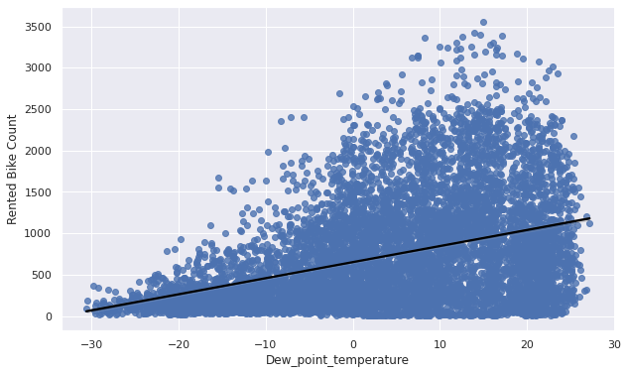
Regression Plot for numerical variable

Slide 19
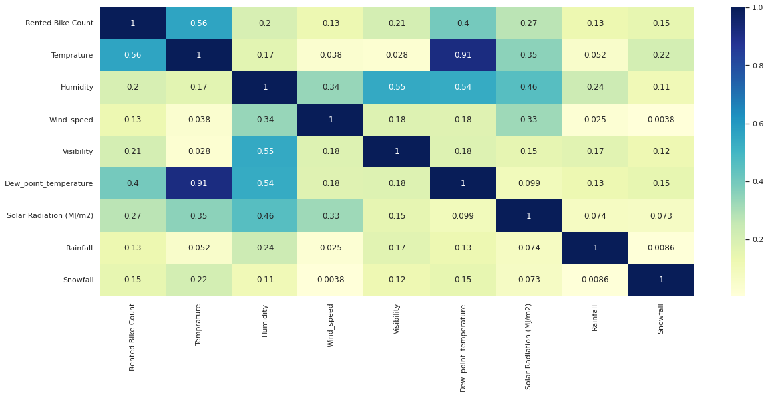
Correlation Heatmap

Slide 20
MODEL BUILDING

Slide 21
Models:
➢ LINEAR REGRESSION
➢ LASSO REGRESSION
➢ RIDGE REGRESSION
➢ DECISION TREES
➢ RANDOM FOREST
➢ RANDOM FOREST WITH GRIDSEARCHCV
➢ GRADIENT BOOSTING
➢ GRADIENT BOOSTING WITH GRIDSEARCHCV

Slide 22
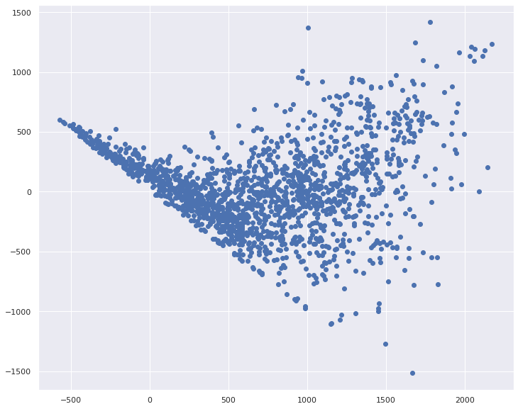
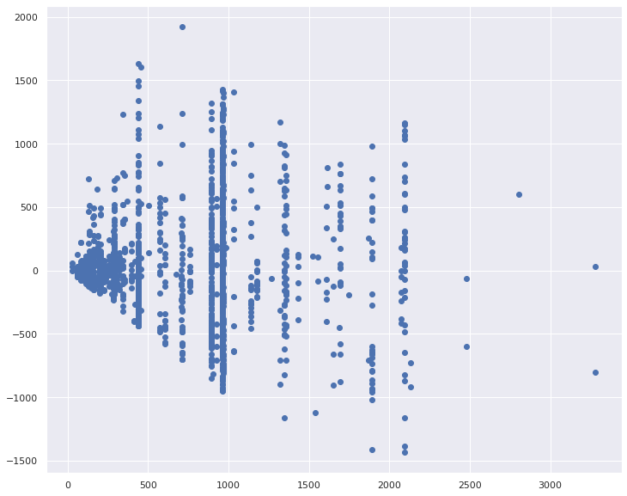
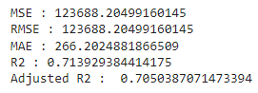
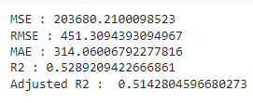
Linear Regression
Decision Tree

Slide 23
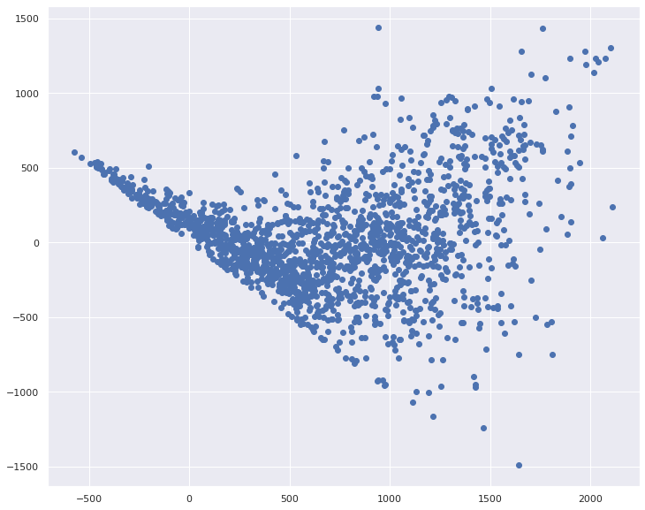

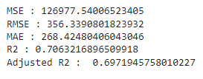
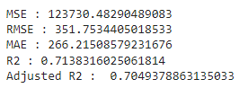
Lasso Regression
Ridge Regression

Slide 24
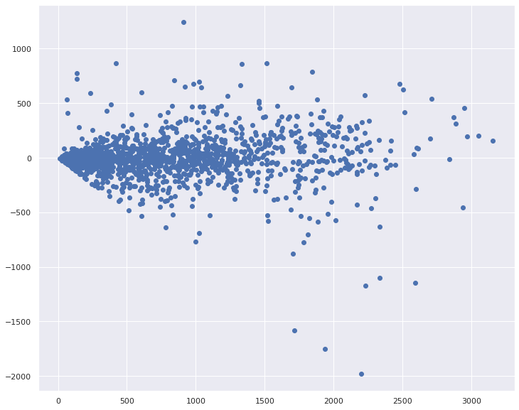
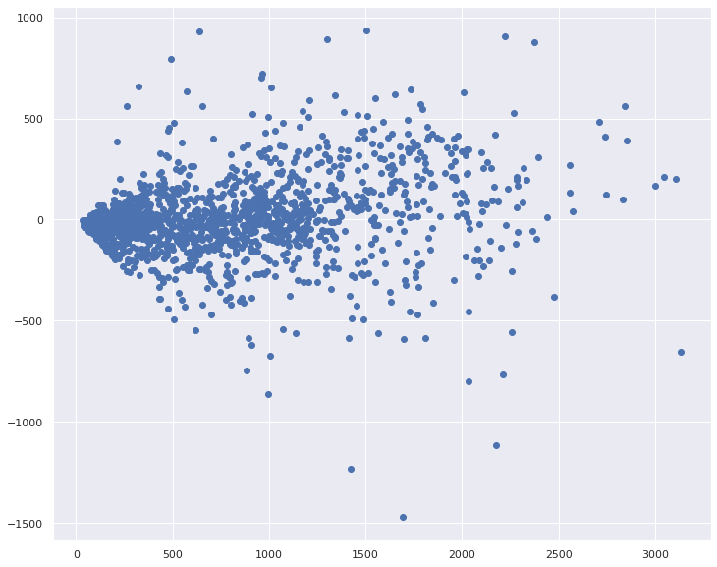
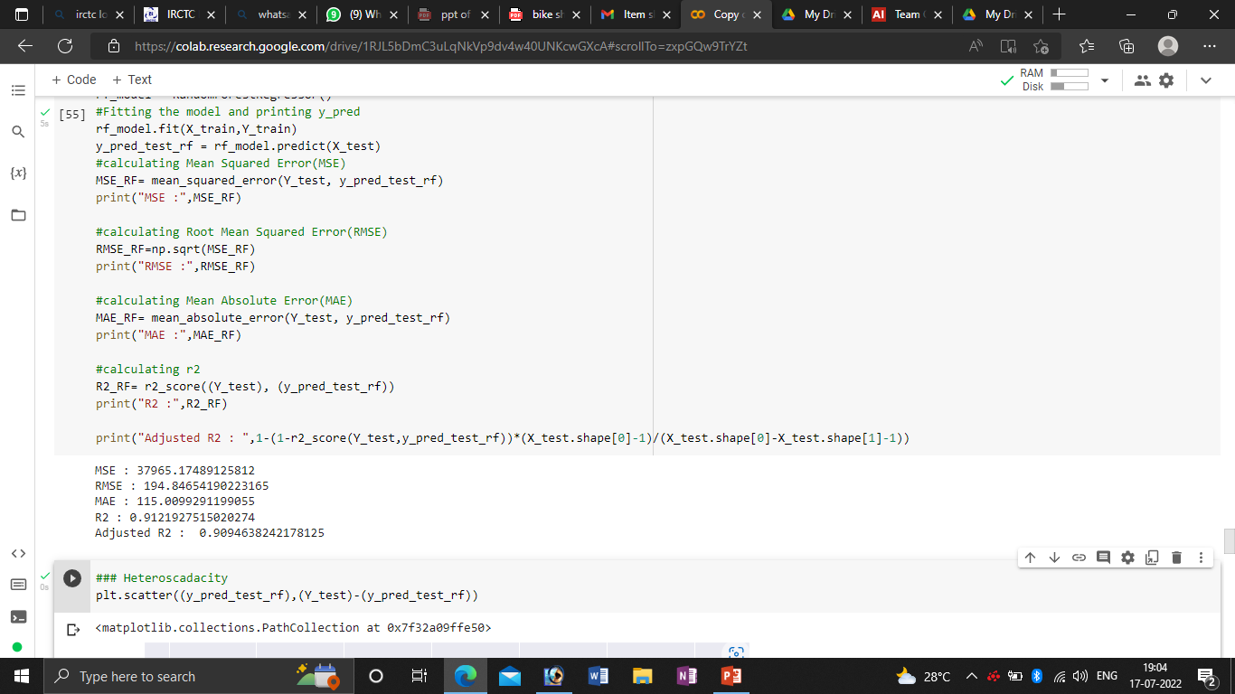
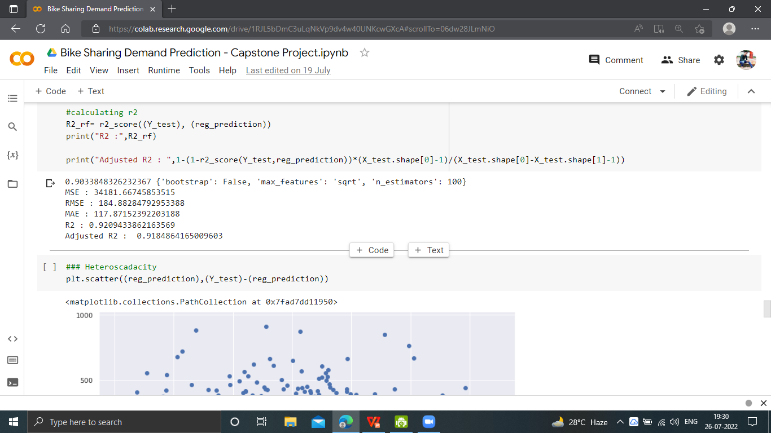
Random Forest
Random Forest with GridsearchCV

Slide 25
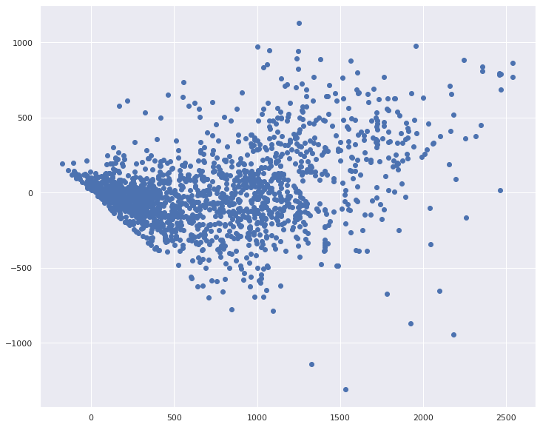
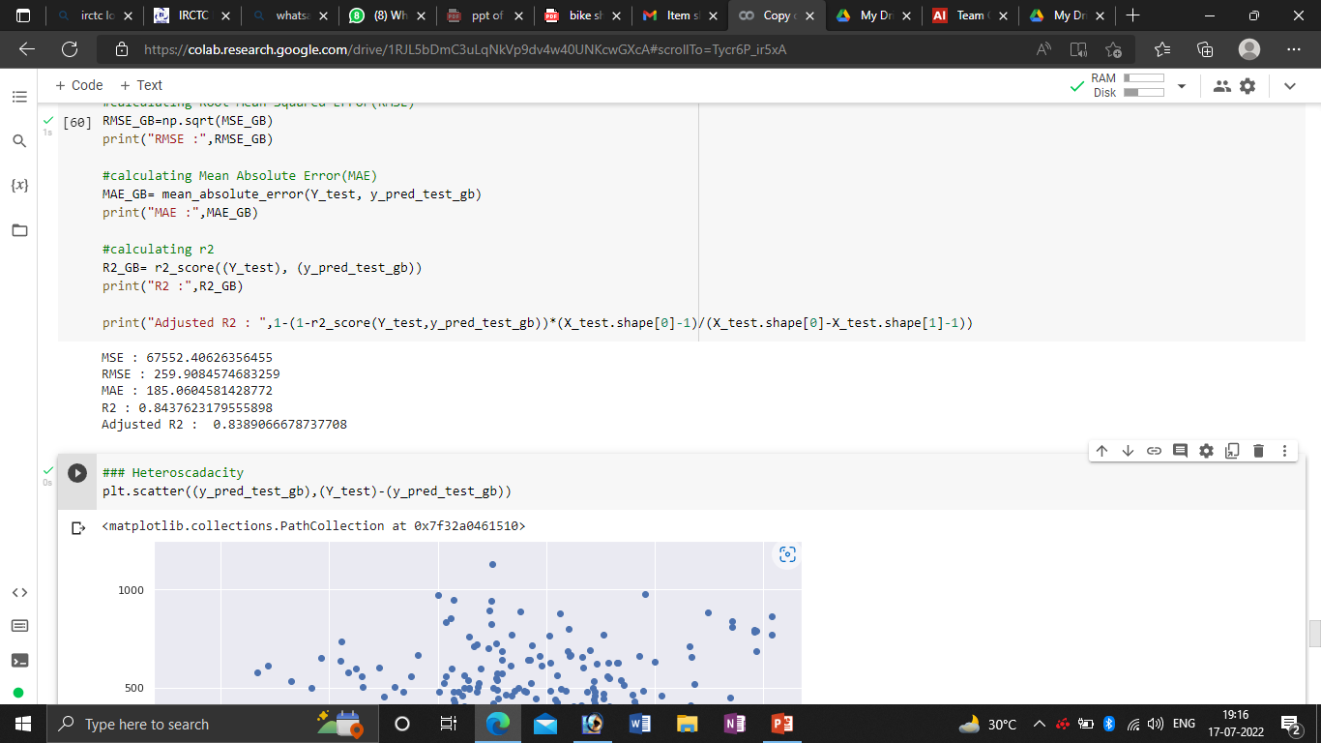
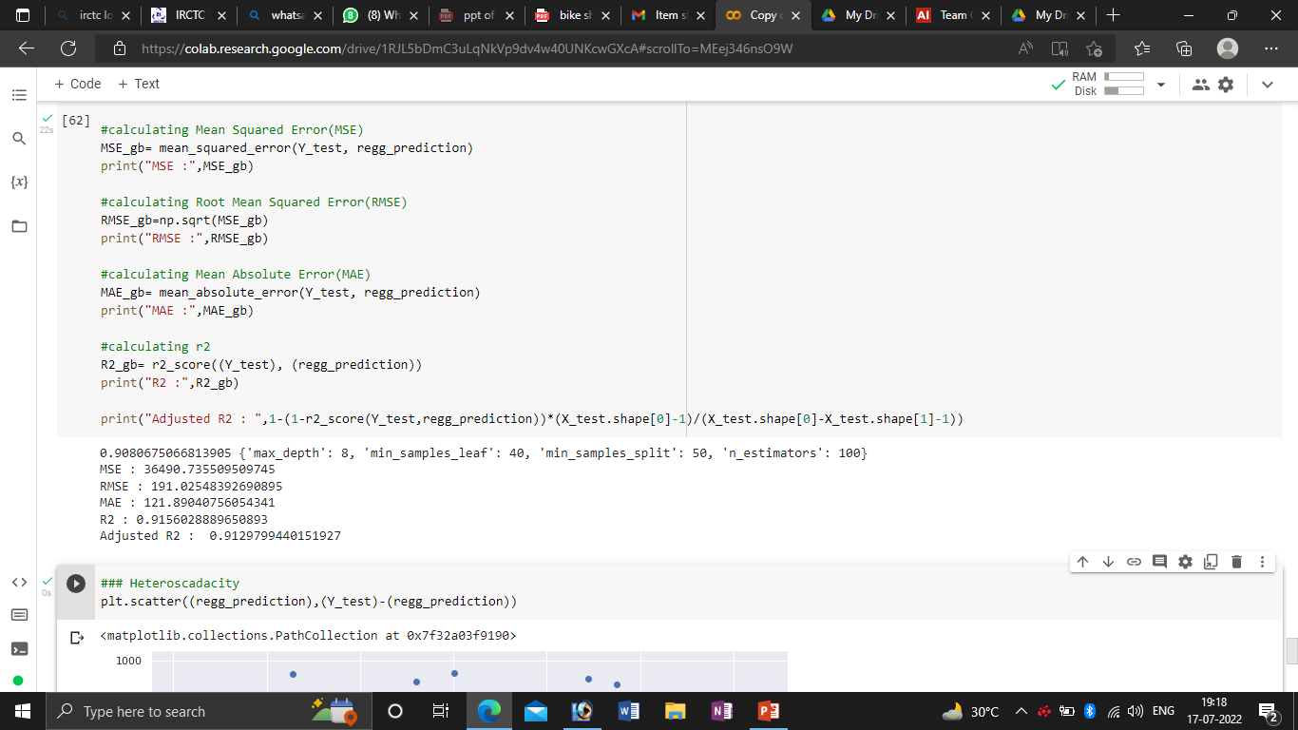
Gradient Boosting
Gradient Boosting with GridsearchCV

Slide 26
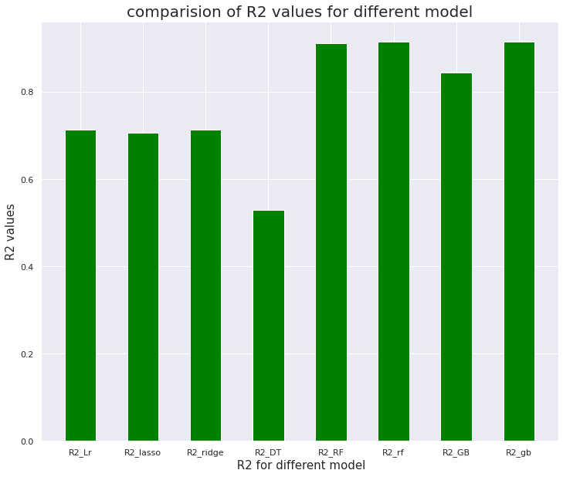
Comparison of R2 values for different model

Slide 27
Conclusion
➢ Bike rental count is mostly correlated with the time of the day as it is peak at 8 am morning and 6 pm at evening.
➢ We observed that bike rental count is high during working days than non working day.
➢ We see that people generally prefer to bike at moderate to high temperatures, and when little windy
➢ It is observed that highest number bike rentals counts in Autumn & Summer seasons & the lowest in winter season.
➢ We observed that the highest number of bike rentals on a clear day and the lowest on a snowy or rainy day. We observed that with increasing humidity, the number of bike rental counts decreases.
➢ When we compare the R2 score of all the models, Random Forest and Gradient Boosting gives the highest Scores of 0.91 and 0.85. And this score increases when we use the hyper parameter tuning.We have R2 score of 0.92 and 0.91 using hyper prameter tuning of the same models. So this model is the best for predicting the bike rental count on daily basis.

Slide 28
Thank You

